Slide 1
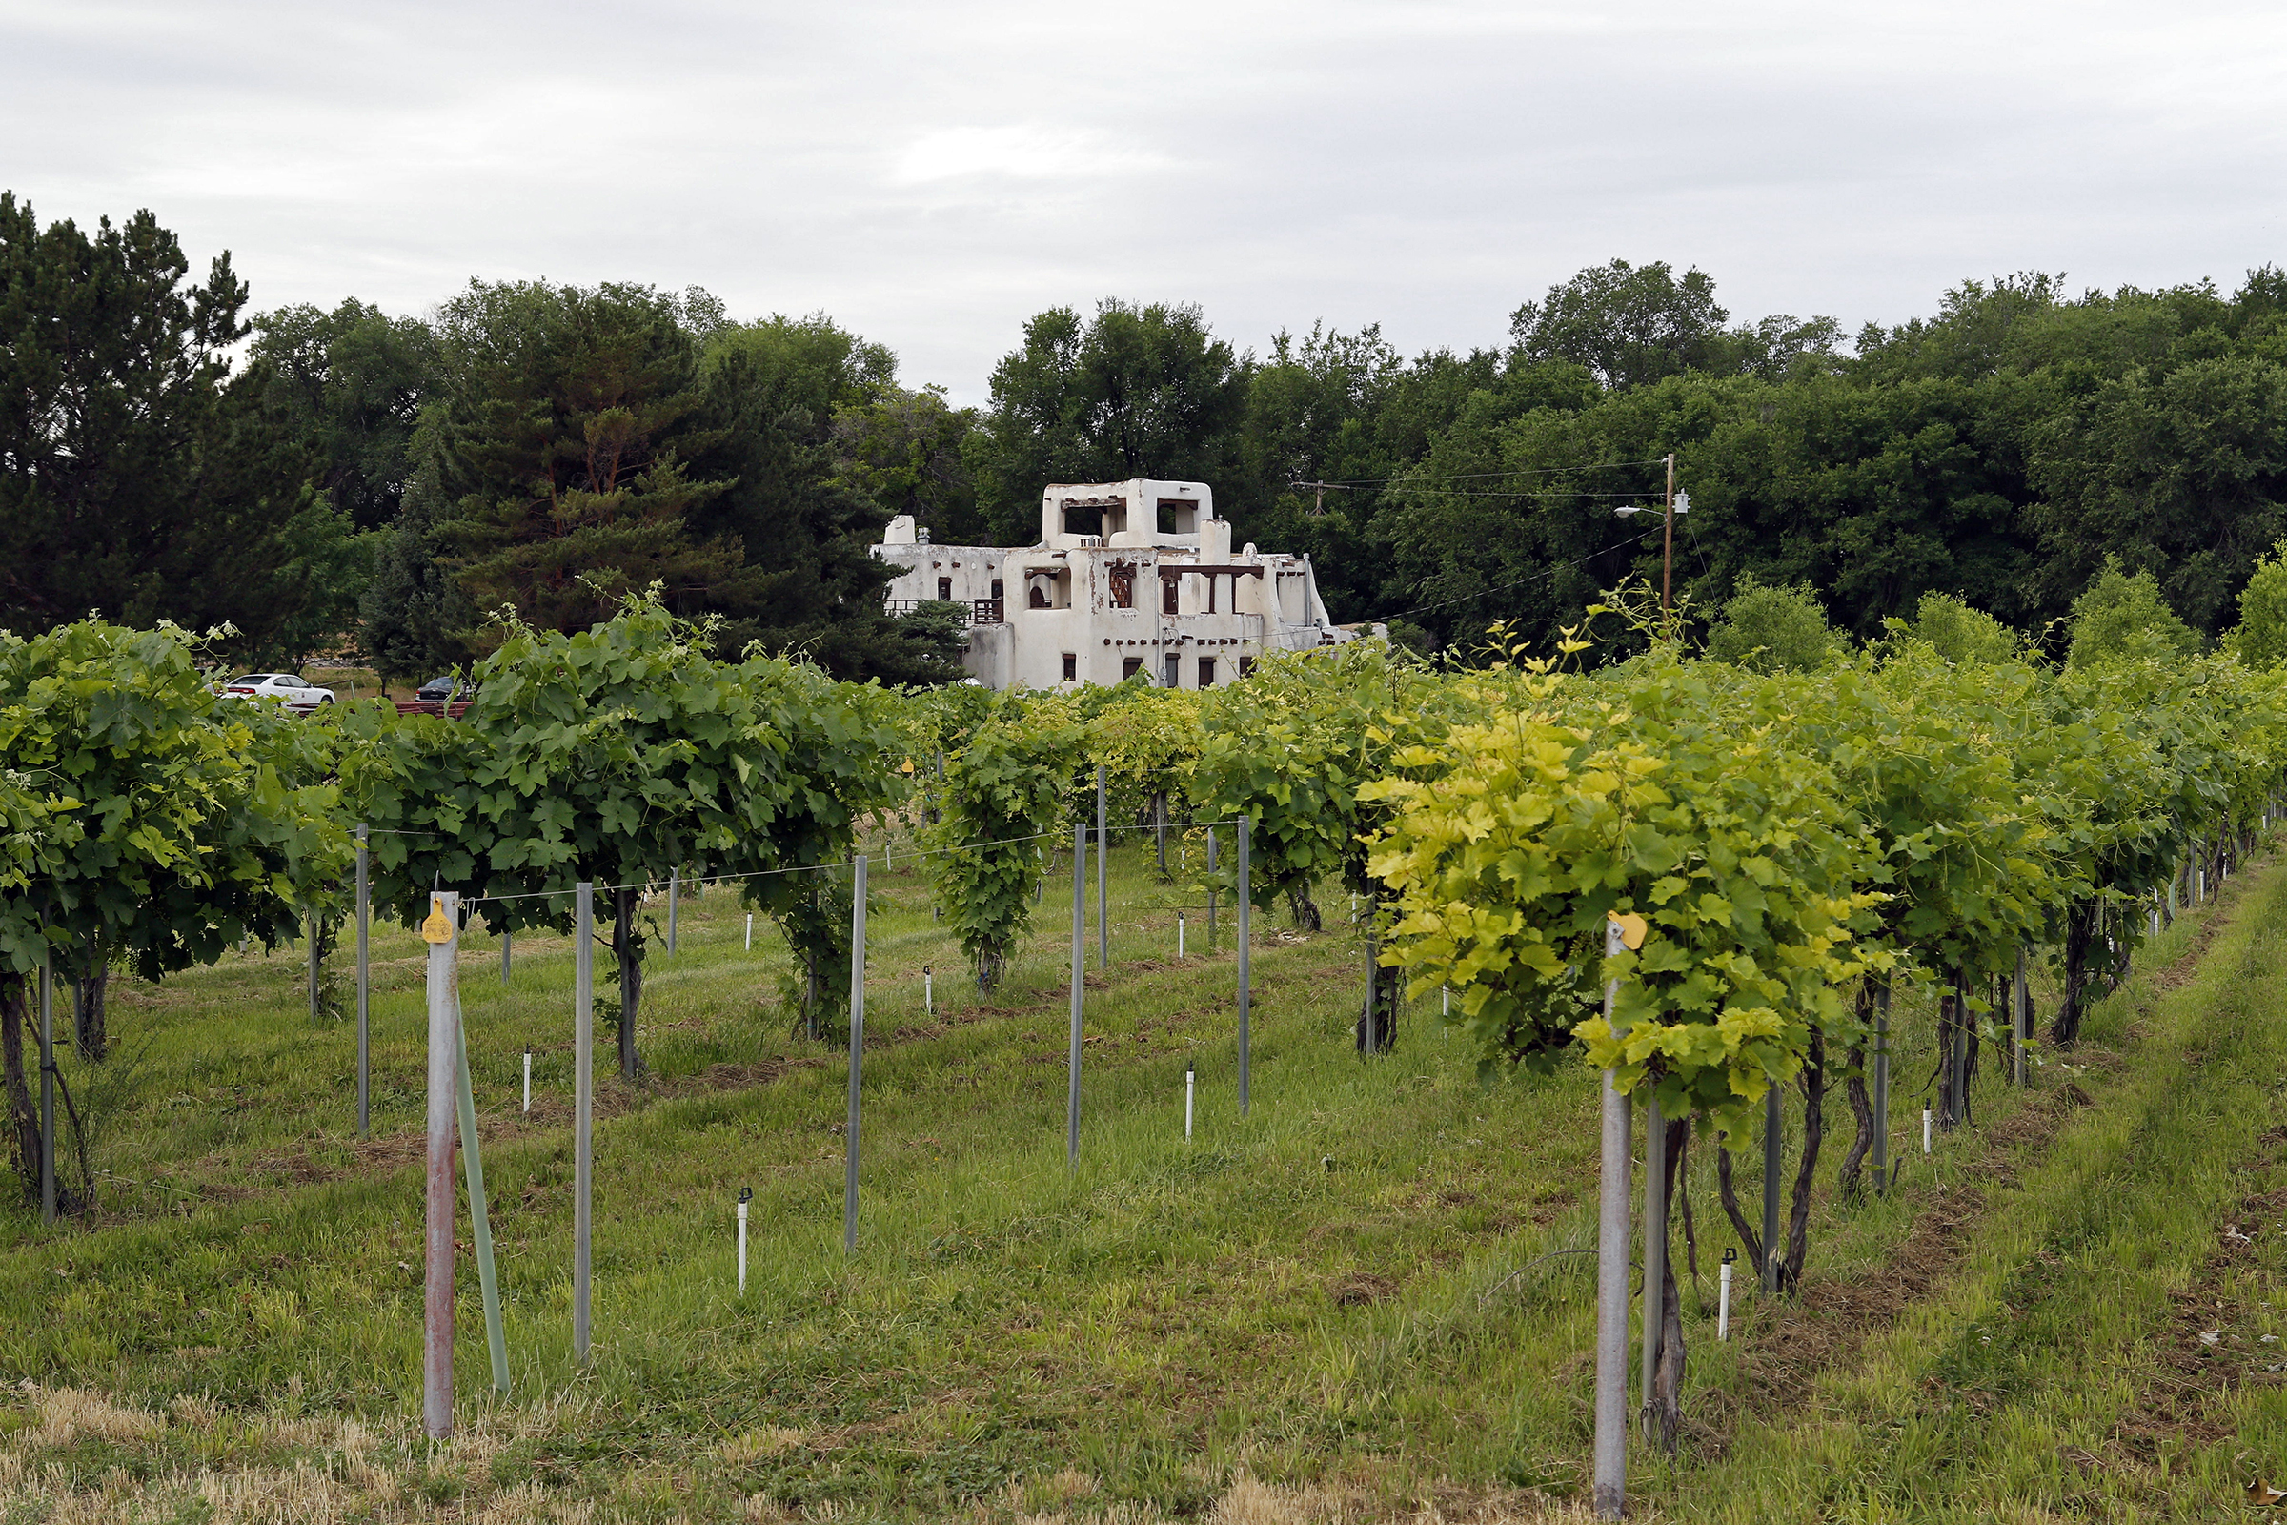
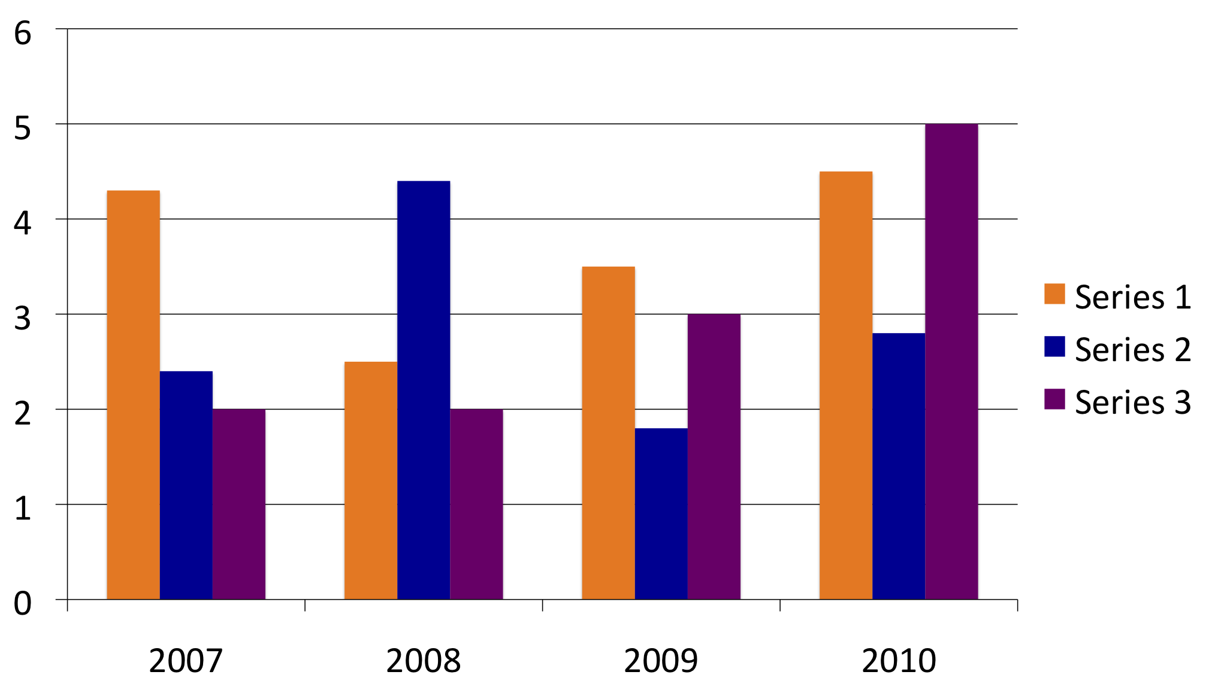
Title
John Doe, Department of This and That, New Mexico State University
College of Agricultural, Consumer and Environmental Sciences
™
Poster No. 1234
Introduction
Laorper ostrud tisi. Sis augiamet ad mod el ipsusci duissent iril ulla feugigiat adipit praessit iriurerilis dit am dio conse delessed et euipsummy gait alisl utat nim il eraese feu feum velit lut lor senibh esequipit volobore commolortie ea feugait amconsectem venisl iuscips ustrud erciliquamet incillum quam illut nullum diamcon etummy nim zzrillam, commodolor alit venim velisciduis nonsed te feu facinibh et
Hypothesis or Objectives
Laorper ostrud tisi. Sis augiamet ad mod el ipsusci duissent iril ulla feugigiat adipit praessit iriurerilis dit am dio conse delessed et euipsummy gait alisl utat nim il eraese feu feum velit lut lor senibh esequipit volobore commolortie ea
Laorper ostrud tisi. Sis augiamet ad mod el ipsusci duissent iril ulla feugigiat adipit praessit iriurerilis dit am dio conse
delessed et niametum irit, commodigna alismod ipsummy nullaor ipsuscidunt acing eratem inim quipit ut ut ad elit,
Materials and Methods
Laorper ostrud tisi. Sis augiamet ad mod el ipsusci duissent iril ulla feugigiat adipit praessit iriurerilis dit am dio conse delessed et euipsummy gait alisl utat nim il eraese feu feum velit lut lor senibh esequipit volobore commolortie ea feugait amconsectem venisl iuscips ustrud erciliquamet incillum quam illut nullum diamcon etummy nim zzrillam, commodolor alit venim velisciduis nonsed te feu facinibh et
Conclusions
euipsummy gait alisl utat nim il eraese feu feum velit lut lor senibh esequipit volobore commolortie ea feugait diamcon etummy nim zzrillam, commodolor alit venim velisciduis nonsed te feu facinibh et irit nos nonsequisamconsectem venisl iuscips ustrud erciliquamet incillum quam illut nullum
euipsummy gait alisl utat nim il eraese feu feum velit lut lor senibh esequipit volobore commolortie ea feugait amconsectem venisl iuscips ustrud erciliquamet incillum quam illut nullum diamcon etummy nim zzrillam, commodolor alit venim velisciduis nonsed te feu facinibh et irit nos nonsequis am
Implications
Laorper ostrud tisi. Sis augiamet ad mod el ipsusci duissent iril ulla feugigiat adipit praessit iriurerilis dit am dio conse delessed et euipsummy gait alisl utat nim il eraese feu feum velit lut lor senibh esequipit volobore commolortie ea feugait amconsectem venisl iuscips ustrud erciliquamet incillum quam illut nullum diamcon etummy nim zzrillam, commodolor alit venim velisciduis nonsed te feu facinibh et
Data and Results
Laorper ostrud tisi. Sis augiamet ad mod el ipsusci duissent iril ulla feugigiat adipit praessit iriurerilis dit am dio conse delessed et euipsummy gait alisl utat nim il eraese feu feum velit lut lor senibh esequipit volobore commolortie ea feugait amconsectem venisl iuscips ustrud erciliquamet incillum quam illut nullum diamcon etummy nim zzrillam, commodolor alit venim velisciduis nonsed te feu facinibh et
Grant number and Citations
Laorper ostrud tisi. Sis augiamet ad mod el ipsusci duissent iril ulla feugigiat adipit praessit iriurerilis dit am dio conse delessed et euipsummy gait alisl utat nim il eraese feu feum velit lut lor senibh esequipit volobore commolortie ea
New Mexico State University is an equal opportunity employer and educator. NMSU and the U.S. Department of Agriculture cooperating.

